Slide 1
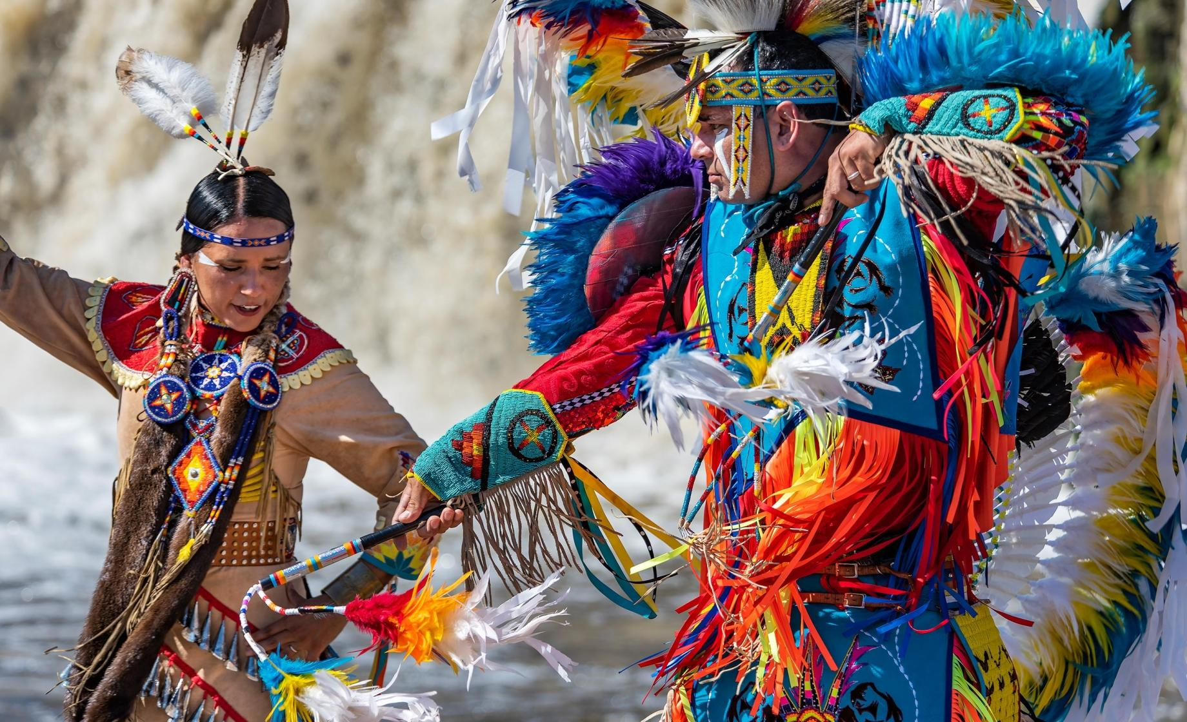
TRIBAL AFFAIRS CAUCUS
The IAEM-USA Tribal Affairs Caucus formed in 2000, to facilitate emergency services and program awareness in Indian Country.
Native American communities, commonly found in remote areas, are among the most vulnerable to natural disasters and emergencies due to their unique cultural and historical circumstances.
Native American emergency management and relief efforts face unique challenges due to historical and systemic factors, as well as limited resources and staffing.
Accomplishments: ➢ Added National partnerships ➢ Provided support to membership through partnership engagements and IAEM AEM/CEM sponsorships ➢ Coordinated stakeholder presentations to enhance awareness of programs in direct support of Tribal Emergency Manager’s ➢Increased outreach to tribes
Future Projects: ➢ Engaging tribal governments and Emergency managers in information-sharing and coordination ➢ Continue increasing membership ➢ Continue increasing partner engagement
➢ Presentations at future conferences
Caucus Chair: Angie Ramos Caucus Vice Chair: Lisa Figueroa, CEM Board Liaison: John Osborne
➢ IAEM Conference meeting Wednesday, November 8th at 4p
➢Quarterly Zoom meeting December 15th, 1pm EST

