Slide 1
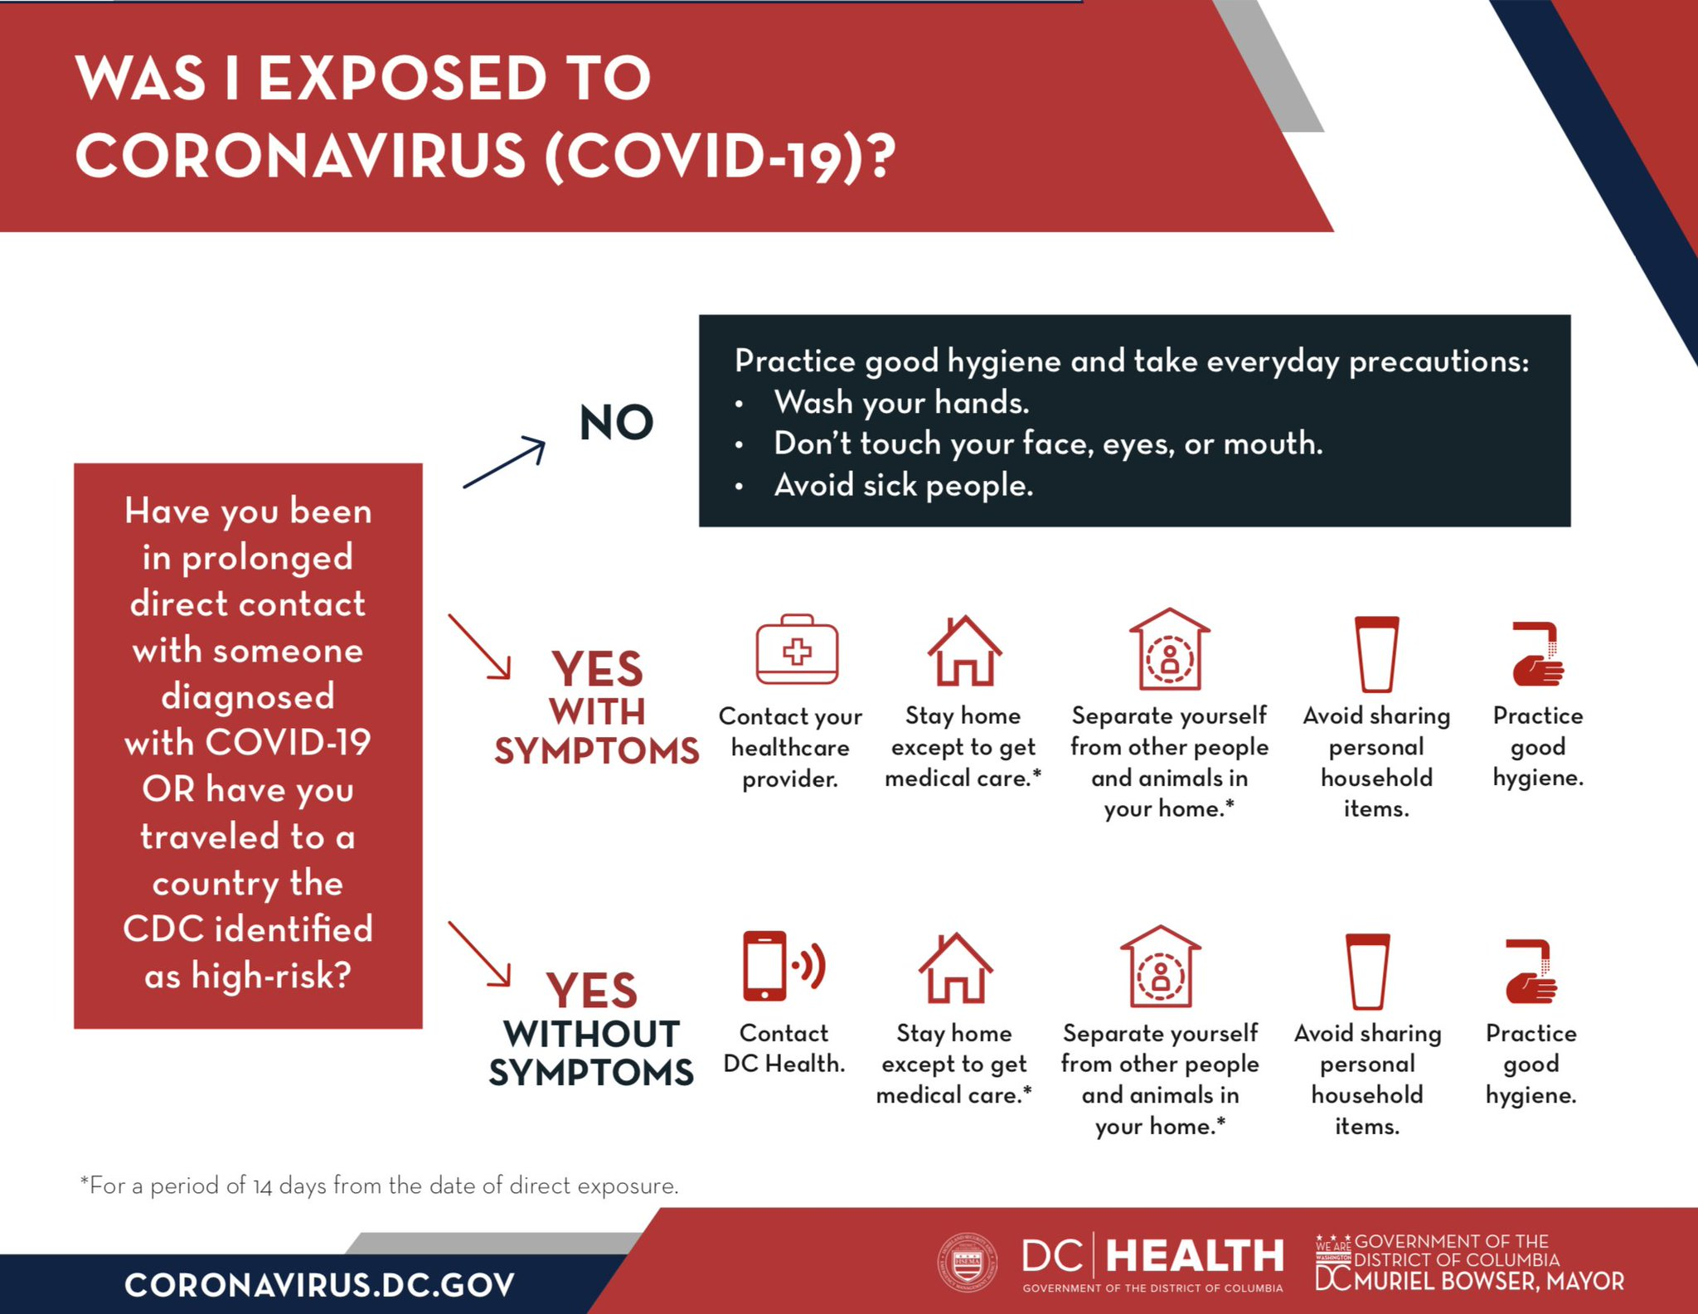

Slide 2






WAS I EXPOSED TO
CORONAVIRUS (COVID-19)?
Practice good hygiene and take everyday precautions:
Wash your hands frequently
Don’t touch your face, eyes, or mouth
Avoid sick people
Have you been in prolonged direct contact with someone diagnosed with COVID-19 OR have you traveled to a country the CDC identified as high-risk?
NO
YES
with
Symptoms*
Contact your healthcare provider.
Stay home except to get medical care.**
Separate yourself from other people and animals in your home.**
Avoid sharing personal household items.
Practice good hygiene.
YES
without
symptoms
Contact your Local Health Department
Stay home except to get medical care.**
Separate yourself from other people and animals in your home.**
Avoid sharing personal household items.
Practice good hygiene.
More info at:
www.cdc.gov/COVID19
*Per the CDC, Symptoms include: Fever, Cough, Shortness of Breath
**For a period of 14 days from the date of direct exposure

